Slide 1
ICS 第十一次小班课
小班教师：金芝老师
助教：龚晨

Slide 2
Demand Paging (detail)
Process
Pages are evicted to disk when memory is full
Pages loaded from disk when referenced again
References to evicted pages cause a page fault
PTE was invalid, causes fault
OS allocates a page frame, reads page from disk
When I/O completes, the OS fills in PTE, marks it valid, and restarts faulting process
Dirty vs. clean pages
Actually, only dirty pages (modified) need to be written to disk
Clean pages do not – but you need to know where on disk to read them from again (PTE valid bit = 0)
2

Slide 3
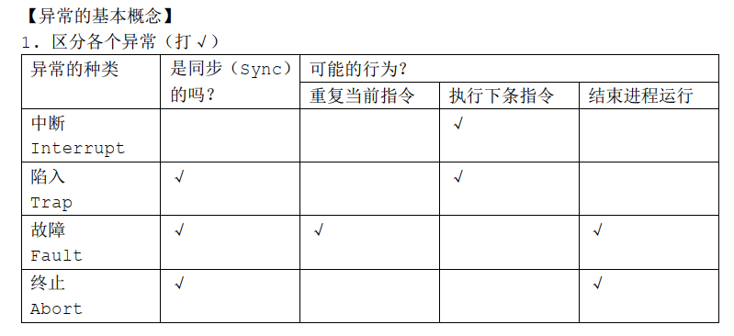
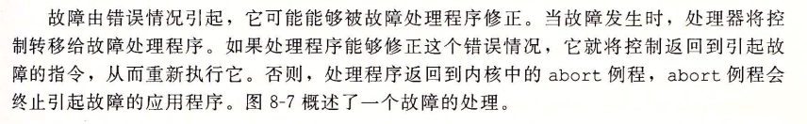

Slide 4
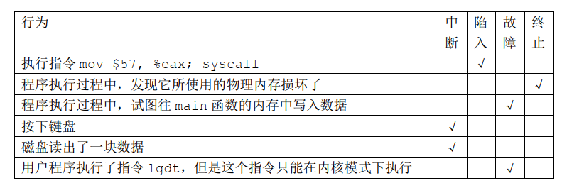
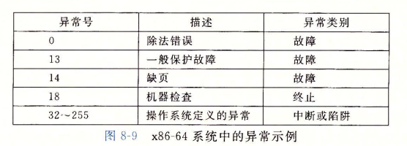

Slide 5
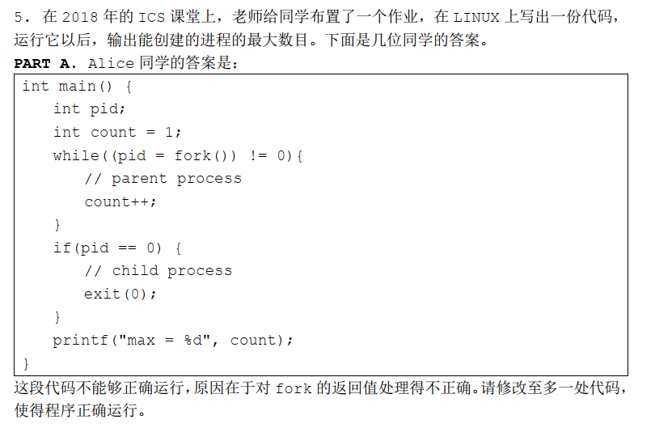

Slide 6
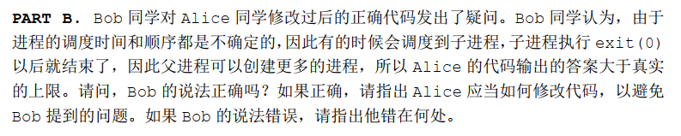

Slide 7
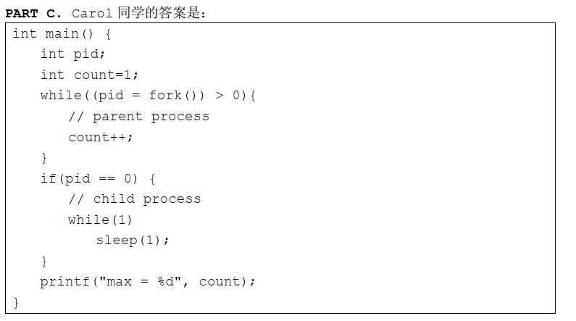
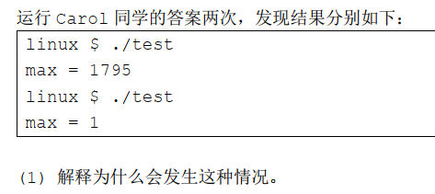

Slide 8
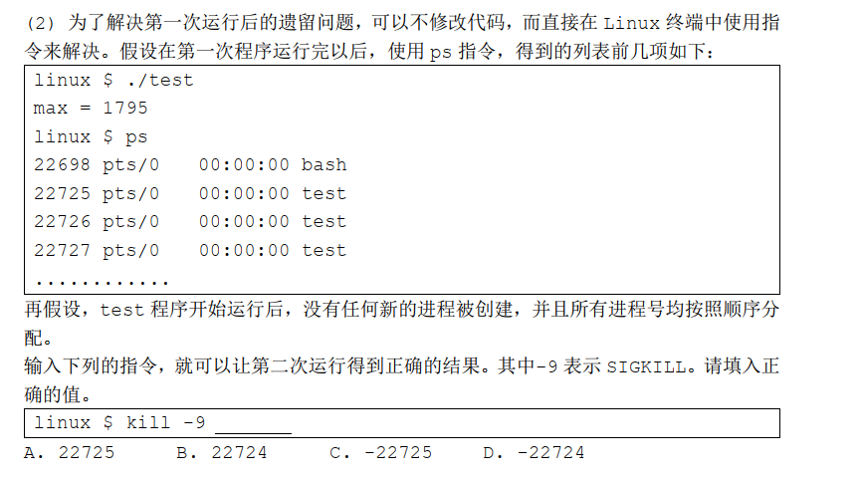
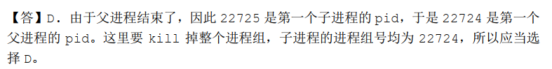
In general, the process group ID is equal to the process ID of the process that created the process group — and that process created the process group by putting itself in the group.

Slide 9
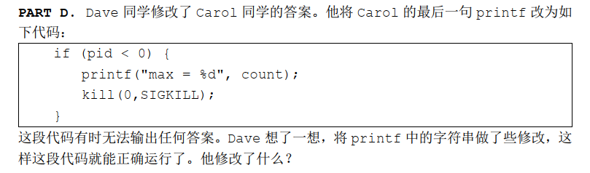

Slide 10
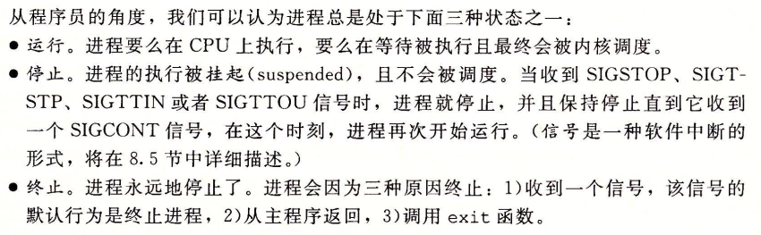
进程状态

Slide 11
停止 & 终止
SIGINT The terminal sends it to the foreground process when the user presses ctrl-c. The default behavior is to terminate the process, but it can be caught or ignored. The intention is to provide a mechanism for an orderly, graceful shutdown.
SIGTERM default to terminate the process, also can be caught or ignored.
SIGKILL The only behavior is to kill the process, immediately. As the process cannot catch the signal, it cannot cleanup, and thus this is a signal of last resort.
SIGSTOP The only behavior is to pause the process; the signal cannot be caught or ignored.

Slide 12
信号
信号本质上是在软件层次上对中断机制的一种模拟
进程之间可以互相通过系统调用发送信号
内核也可以因为内部事件而给进程发送信号，通知进程发生了某个事件
进程控制块
PCB
SIG
SIG
SIG
挂起信号队列
信号处理程序描述符
action 0
action 1
action 2
action 29

Slide 13
信号举例：异常
当程序发生除0错误或是有非法指令时，将引起一个内核态的 trap
内核trap处理程序识别出这个异常并发送合适的信号到当前进程
将信号加入进程的挂起信号队列中
当trap处理程序将要返回到用户态时，内核会检查并发现信号，进而执行信号处理函数
内核会检查进程中该信号的处理程序描述符，进而决定是忽略该信号、或执行默认处理程序、或执行进程自己注册的处理程序
进程自己注册处理程序，实际就是修改信号处理程序描述符的内容

Slide 14
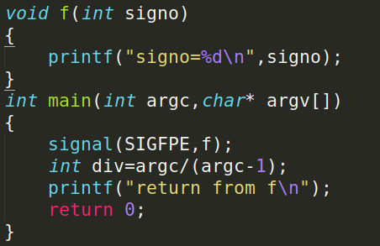
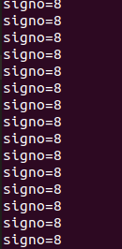
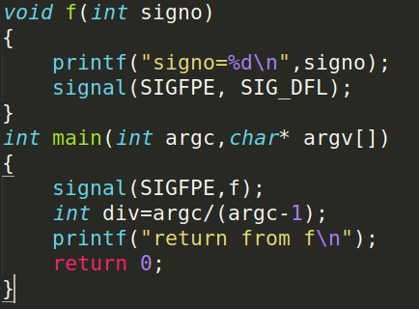
SIGPFE
每次系统调用信号处理函数后，还会继续返回到除零那里继续执行，因此陷入死循环。
可以在信号处理函数中恢复系统默认处理

Slide 15
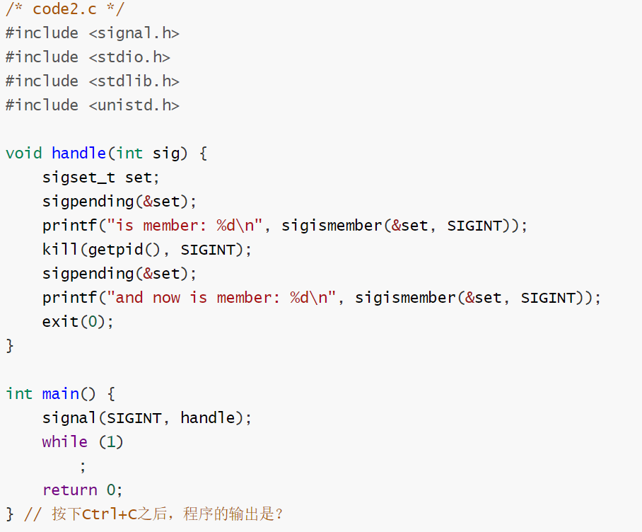

Signal nesting

Slide 16
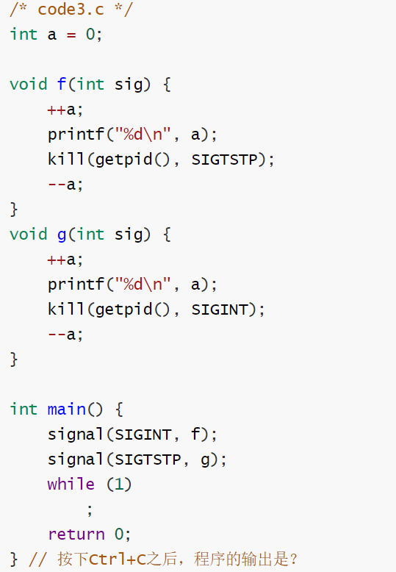
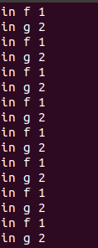
Signal nesting

Slide 17
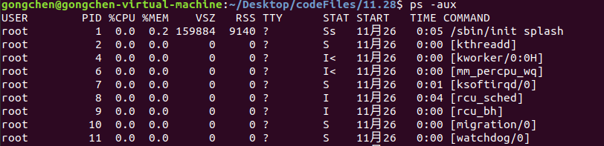
ps command
u detailed information.
Among the information that ‘ps –aux’ provides about each process is the user of the process, the PID, the percentage of CPU used by the process, the percentage of memory used by the process, VSZ (virtual size in kilobytes), RSS (real memory size or resident set size in 1024 byte units), STAT (the process state code), the starting time of the process, the length of time the process has been active and the command that initiated the process.
The process state codes include D, uninterruptable sleep; N, low priority; R, runnable (on run queue); S, sleeping; T, traced or stopped; Z, defunct (zombie).
http://www.linfo.org/ps.html

Slide 18
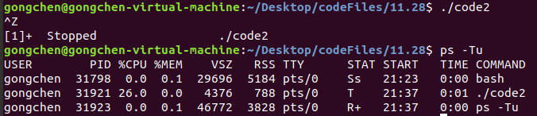
ps command
TIME 00:00:00. It is nothing but the total accumulated CPU utilization time for any process and 00:00:00 indicates no CPU time has been given by the kernel till now. In above example we found that, for bash no CPU time has been given. This is because bash is just a parent process for different processes which needs bash for their execution and bash itself is not utilizing any CPU time till now.
-T: View all processes associated with this terminal
https://www.geeksforgeeks.org/ps-command-in-linux-with-examples/

Slide 19
理解x86-64地址翻译
2017-11-23

Slide 20
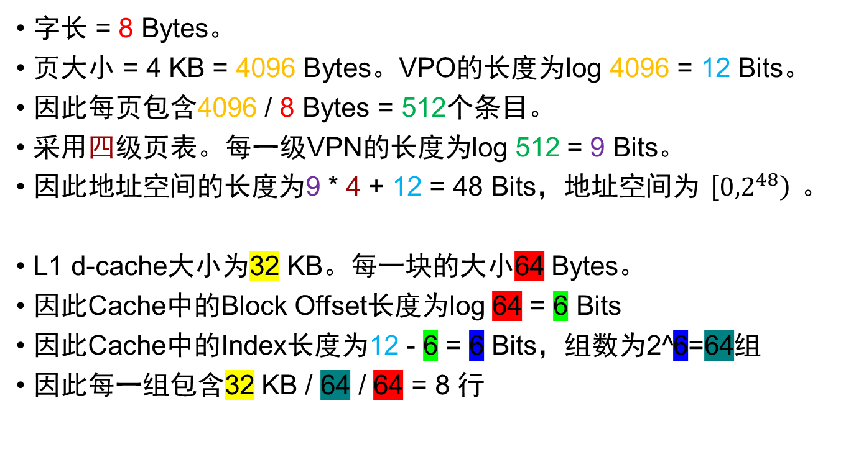
x86-64
字长 = 8 Bytes。
页大小 = 4 KB = 4096 Bytes。VPO的长度为log 4096 = 12 Bits。
因此每页包含4096 / 8 Bytes = 512个条目。
采用四级页表。每一级VPN的长度为log 512 = 9 Bits。
因此地址空间的长度为9 * 4 + 12 = 48 Bits，地址空间为$\left[{0,2}^{48}\right)$。
L1 d-cache大小为32 KB。每一块的大小64 Bytes。
因此Cache中的Block Offset长度为log 64 = 6 Bits
因此Cache中的Index长度为12 - 6 = 6 Bits，组数为2^6=64组
因此每一组包含32 KB / 64 / 64 = 8 行

Slide 21
VA
48
VPN
VPO
36
12
32
4
TLBT
TLBI
TLB
Miss
TLB
Hit
L1 TLB
9
9
9
9
1
2
3
4
PPN
PPO
40
12
PA
L1 Cache
CR3
PML4 PDPT PD PT

Slide 22
总线
40
6
6
PA
CT
CI
CO
L1 d-cache: 8行/组
set0
set1
set2
Cache Hit
...
set62
set63
Cache Miss
主存
setCI

Slide 23
总线
VA
VPN
VPO
40
CI
CO
PA
CT
CI
CO
6
6
L1 d-cache: 8行/组
set0
set1
set2
...
Cache Hit
set62
set63
Cache Miss
主存
setCI

Slide 24
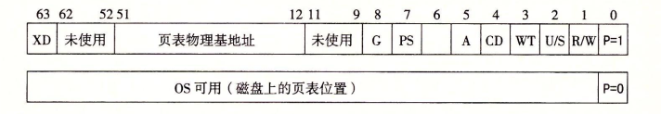
区分L1 cache和TLB
DRAM（主存）不命中比SRAM（L1/2/3 cache）不命中昂贵得多。DRAM是全相联的，任何虚拟页都可以放在任何物理页中。
DRAM使用写回。写回&直写，写分配&非写分配
页面命中完全由硬件处理；缺页要求硬件和操作系统内核协同完成：MMU检查PTE，触发异常，传递控制给操作系统内核中的缺页处理程序。
访问SRAM高速缓存：大部分系统使用物理地址，便于共享。权限检查是地址翻译时做的（PTE）。
TLB存储页表项，用VPN的位查找，分组号、标记位，因为TLB的一行是由单个PTE组成的块；L1 cache存储要访问的内存位置的值，用整个物理地址查L1，分块偏移、组号、标记位。
页表中包含的地址是物理地址：地址翻译是MMU硬件做的，硬件访问到的是物理地址。CR3中存的是一级页表的起始物理地址

Slide 25
2013年期末
B

Slide 26
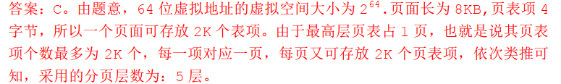
2015年期末

Slide 27
2016年期末
B

Slide 28
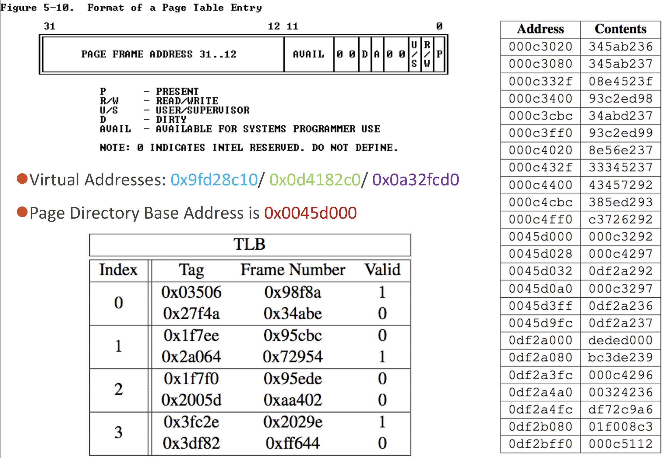
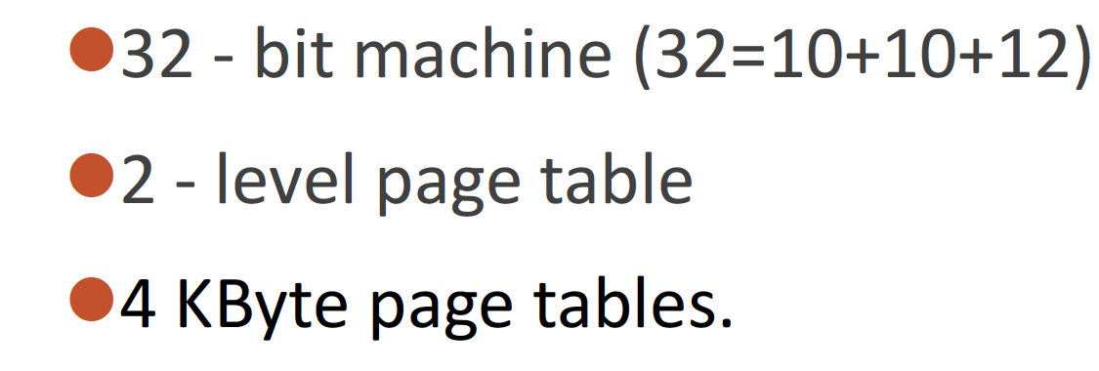
问题：试将右侧三个虚拟地址翻译为物理地址

